Slide 1

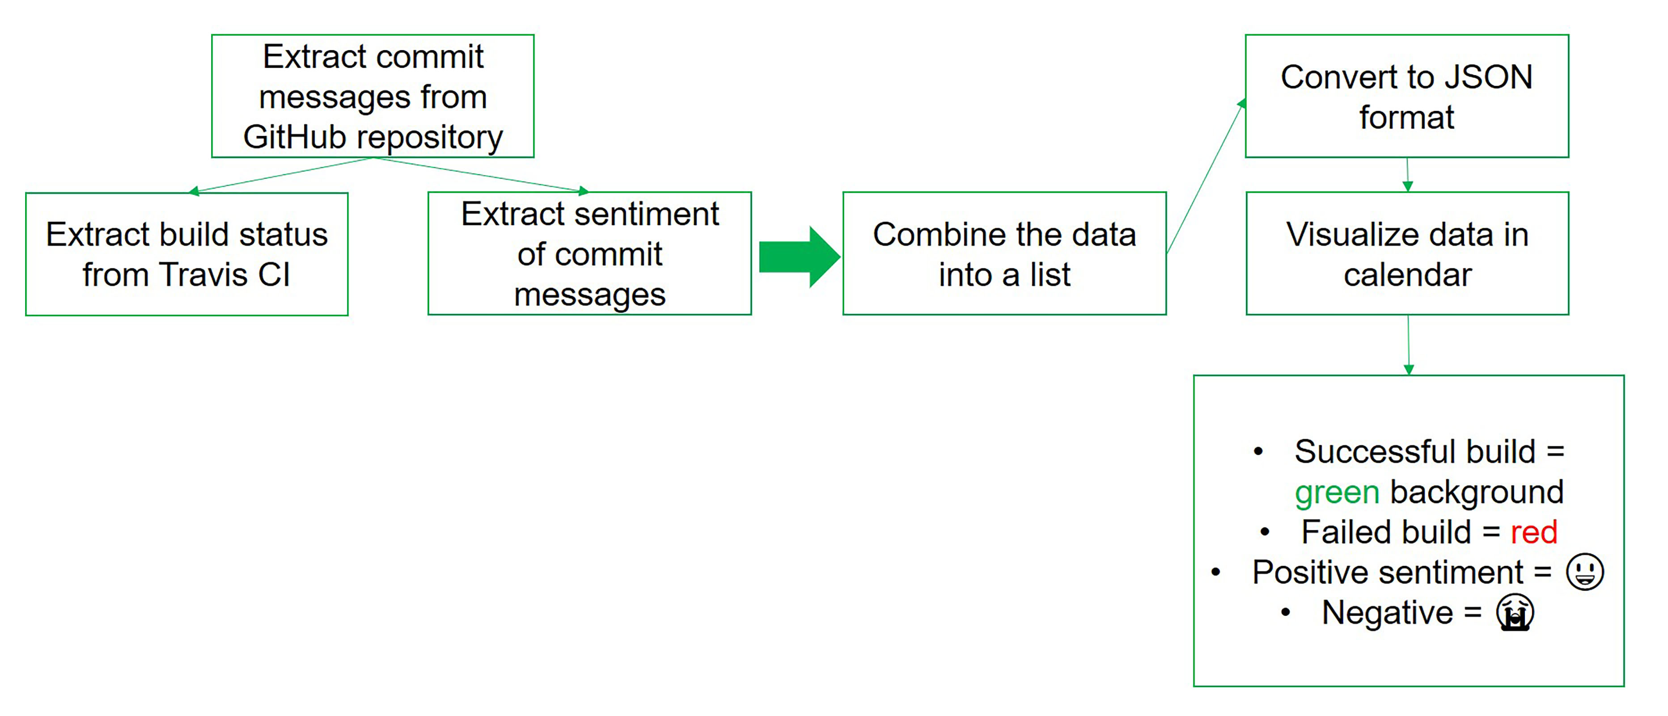


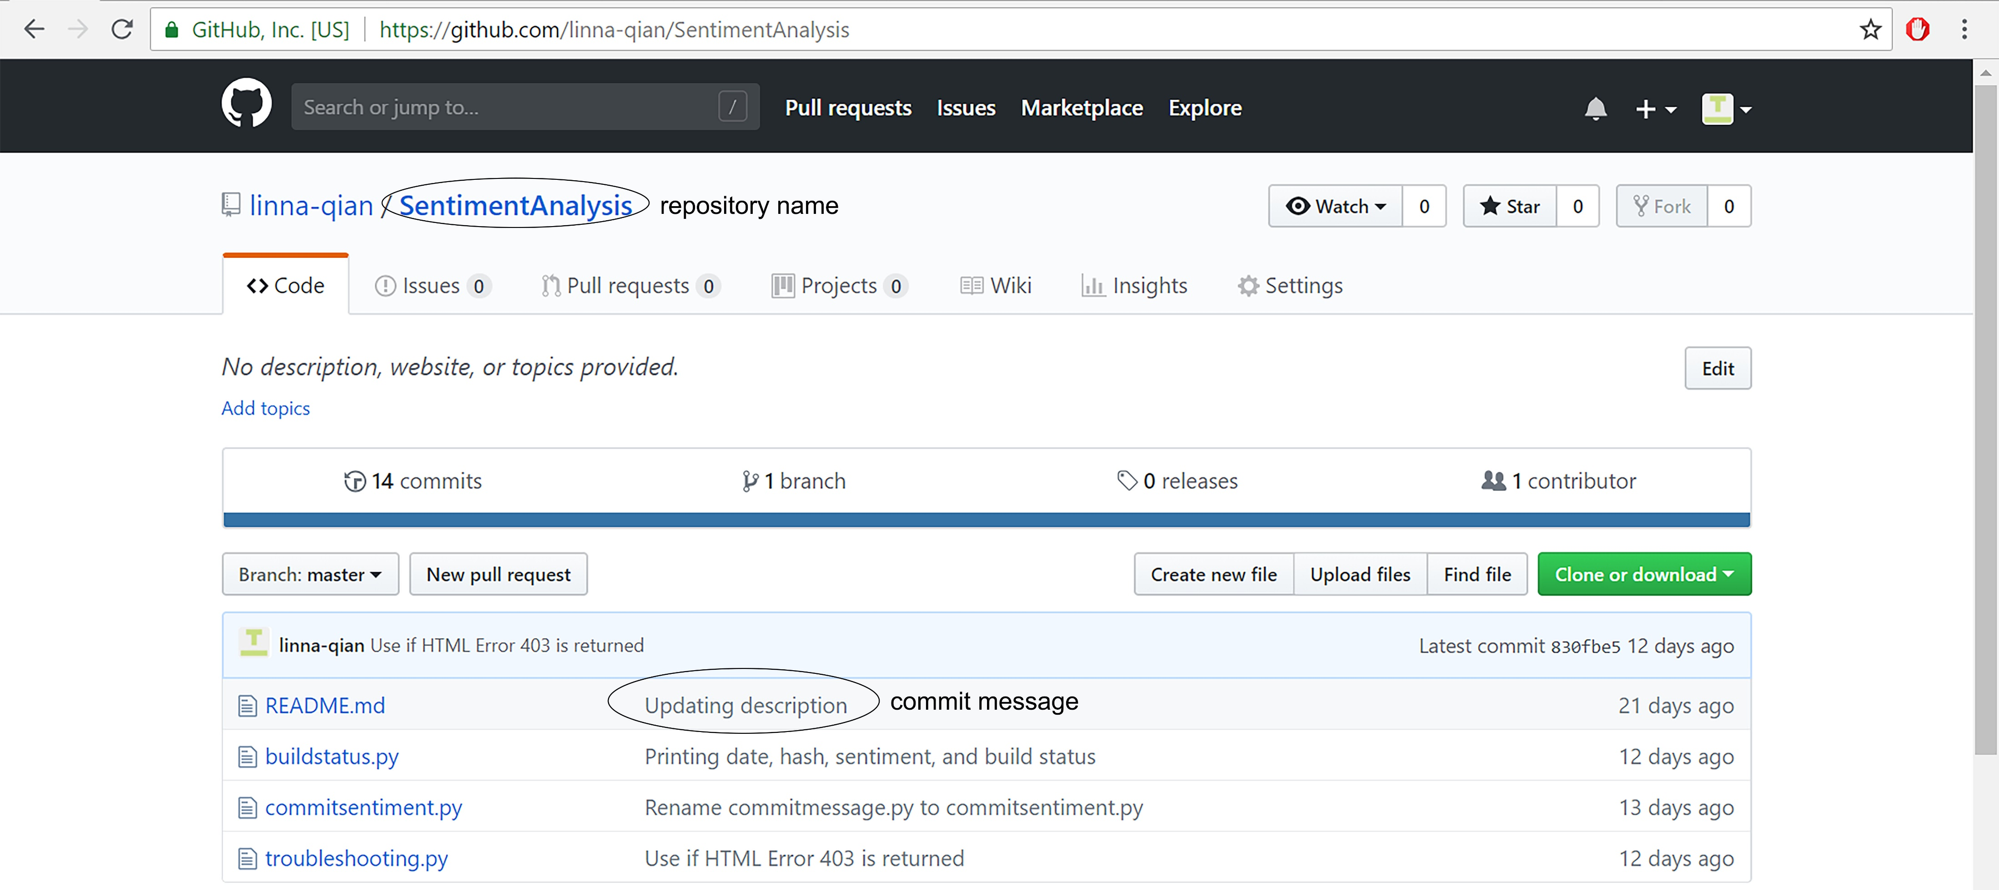
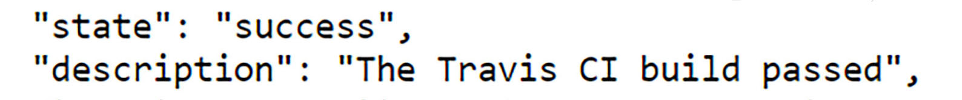
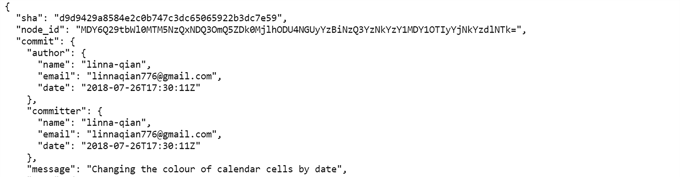
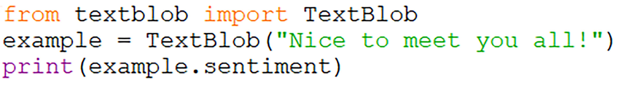
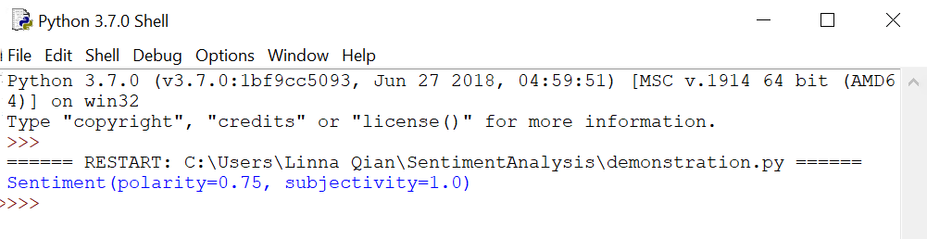
Sentiment Analysis in Program Development
Linna Qian (linna@ualberta.ca) with Dr. Sarah Nadi and Moein Owhadi-Kareshk
Department of Computing Science, University of Alberta
Introduction
Definitions and Examples
Overview of Research Process
The software development process can be affected by its workers
Bad days can affect the production of a company
Difficult for big companies to gauge how employees may feel
GitHub
A website where programmers can store their projects for others to see, use, and develop
Travis CI
A continuous integration platform that automatically builds and tests code changes
Research Question
A GitHub repository is where the contents of a project are stored (project file)
Commit messages are messages that programmers attach to the work when they upload to their repository
Do the feelings of software developers, about their program, affect the success of Travis CI builds?
Results and Conclusion
Continuous Integration
Merging smaller code changes more frequently rather than one big merge at the end
Data provides some evidence that the emotions experienced by software developers may affect the success of program builds
Dataset is too small to make a generalization about the relationship between the sentiment of commit messages pushed by developers and the success of their program builds
Sentiment Analysis
Computational process of determining whether the opinion expressed in a piece of text is positive, negative, or neutral¹
Used to determine how people feel about a certain topic
Plays an important role in social media and other business initiatives
Used to improve customer service and relations
¹Oxford English Dictionary
Travis CI Builds
The GitHub repository will be copied and tested in a virtual environment. If any part of the build fails, the build status returned will be either errored or failed¹
Future Applications
API (Application Programming Interface)
API is what allows remote servers and web applications to communicate. It receives requests from the user and sends a response back²
Improving the accuracy of sentiment analysis programs
Analyzing, not only text, but pictures and videos
Increasing the complexity of text able to be analyzed (Examples include: sarcasm and hyperboles)¹
JSON (JavaScript Object Notation)
JSON is a formatting used in data transfer between remote servers and web applications
Improvements
¹“Future of Sentiment Analysis and Problems Faced.” DatascienceCMU, 19 Apr. 2014, datasciencecmu.wordpress.com/2014/04/18/future-of-sentiment-analysis-and-problems-faced/.
Project Objectives
Acknowledgements
The sentiment of the commit messages will be extracted with a Python library called TextBlob. It will return the sentiment as a value between -1 and +1
Preprocess the commit messages to remove text like URLs and code snippets
Use multiple repositories to see the relationship between the sentiment of commit messages and the success of Travis CI builds
Adjust sentiment values based on the type of text being analyzed (commit messages for this project)
Use sentiment analysis to extract the sentiment of developer pushed commit messages and compare it to the success of the build
Create a visual representation, in the form of a calendar, from the data extracted
I would like to thank Dr. Sarah Nadi and Moein Owhadi-Kareshk for welcoming me into the SMR lab and giving me the opportunity to learn about sentiment analysis and program development.
I would also like to thank the Ross and Verna Tate foundation for providing me this opportunity through the High School Internship Program (HIP).
¹“Core Concepts for Beginners.” Travis CI Docs, Travis CI, docs.travis-ci.com/user/for-beginners.
²Gazarov, Petr. “What Is an API? In English, Please.” FreeCodeCamp, 13 Aug. 2016, medium.freecodecamp.org/what-is-an-api-in-english-please-b880a3214a82.

